Slide 1
Web Apps

Slide 2
Supports Windows and Linux platforms
Built-in auto scale and load balancing
High availability with auto-patching
Continuous deployment with Git, Team Foundation Server, GitHub and Visual Studio Team Services
Supports WordPress, Umbraco, Joomla! and Drupal
Create a web app.

Slide 3

Jumpstart your app building
Get your web apps into users’ hands faster using .NET, Java, Node.js, PHP and Python on Windows or .NET Core, Node.js, PHP or Ruby on Linux.
Use a fully-managed platform to perform OS patching, capacity provisioning, servers and load balancing.
Configure from CLI or the Azure portal or use prebuilt templates to achieve one-click deployment.

Slide 4
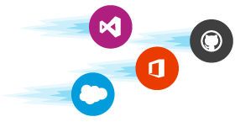
Increase developer productivity
Start fast and finish faster with source code integration from GitHub, live debugging and one-click publish directly from Microsoft Visual Studio IDE.
Easily connect to your database of choice and tap into an ecosystem of OSS packages, APIs, connectors and services through the Azure Marketplace, expediting development.
Quickly add custom domains and SSL, single sign-on (SSO) integration with popular identity providers and application health monitoring to your apps with the Azure portal.

Slide 5

Ship updates faster
Automate deployments with continuous integration/continuous deployment (CI/CD) capabilities using Visual Studio Team Services, Bit Bucket and GitHub.
App Service creates an association with the selected repository, so your apps are updated each time your source code changes.
Schedule performance and quality tests with staging environments, use deployment slots to swap staging to production in seconds and roll back to previous versions without downtime.

Slide 6
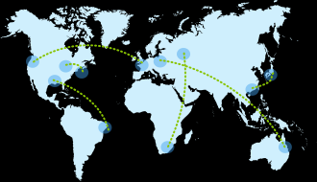
Achieve global scale on demand
Get high availability within and across Azure regions as you deploy data and host services across multiple locations with one mouse click.
Automatically scale vertically and horizontally based on application performance or customizable rules to handle peaks in workload automatically while minimizing costs during off-peak times.
Meet the most rigorous app performance and scalability requirements with the newly introduced D-Series compute option.

Slide 7

Get actionable insights and analytics
View application performance and health end to end, so you can make the decisions that improve your business.
Azure Monitor provides detailed views of resource usage, while Application Insights provides deeper insights into your app’s throughput, response times, memory and CPU utilization and error trends.

Slide 8
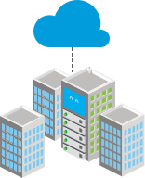
Take advantage of hybrid consistency
Get a flexible and unified approach to building and managing apps that can run across both the cloud and on-premises.
Deploy your apps to App Service in your cloud of choice—Azure, Azure national clouds or even on-premises with Azure Stack.
Securely run your apps in your Azure Virtual Network at large scale with enhanced privacy, power and performance using an App Service Environment.

Slide 9

Choose enterprise-grade services
Host your apps on a highly-secure cloud platform that complies with ISO information security standards, SOC2 accounting standards and PCI security standards and count on App Service to deliver on enterprise-level SLA.
Use Azure Active Directory (AD), as well as other popular identity providers, to authenticate and authorise app access.
Azure AD provides identity management and secured single sign-on (SSO) integration with thousands of cloud SaaS applications

Slide 10
Thanaks

